Slide 1
Chapter 6-1 Page Rank
Dr.Dai Yu

Slide 2
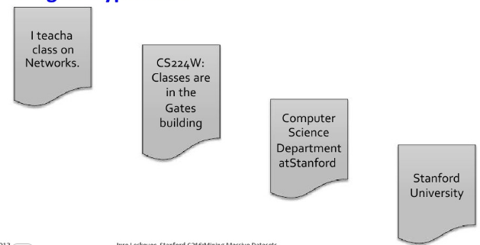
Web as a Graph
Web as a directed graph
Nodes: webpages
Edges: Hyperlinks

Slide 3
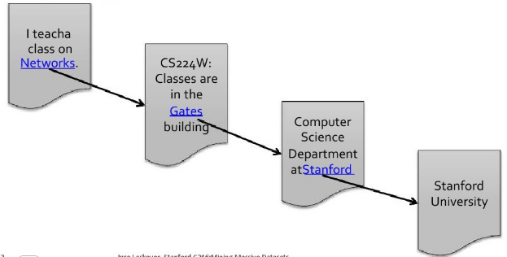
Web as a Graph
Web as a directed graph
Nodes: webpages
Edges: Hyperlinks

Slide 4
Broad Question
How to organize the web?
First Try: Human Methods
Web directories
Second Try: Web Search
Information Retrieval
But: Web is huge, full of untrusted documents, random things, web spam...

Slide 5
Indexing the Web: Goals -> Precision
Short queries applied to very large numbers of items lead to large numbers of hits.
Goal is that the first 10-100 hits presented should satisfy the users' requirement
Recall is not an important critier.
Completeness of index is not an important factor
comprehensive crawling is unnecessary

Slide 6
Challenges
Web contains many souces of information who to trust?
Trustworthy pages may point to each other.
What is the best answer to query “newspaper”?
No Single right answer
Pages that actually know about newspaper might all be pointing to many newspapers

Slide 7
Concept of Document Mearsures
Relevance
Usually estimated by the similarity degree
Importance
measures the documents by thier likelihood of being useful to a variety of users.
Usually estimated by popularity
Rank by a combination of relevance and importance.

Slide 8
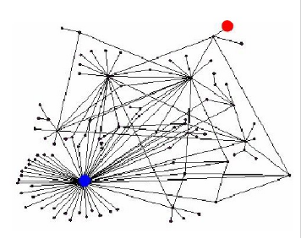
Ranking Nodes on the Graph
All web pages are not equally important
There is large diversity in the web graph node connectivity.
Let's rank the pages by the link structure.

Slide 9
Bibliometrics
Techniques that use citation analysis to measure the similarity of journal articles or their importance
Bibliographic coupling: two papers that cite many of the same papers
Co-citation: two papers that were cited by many of the same papers
Imparct factor: frequence with which the average article in a journal has been cited in a particular year or period.

Slide 10
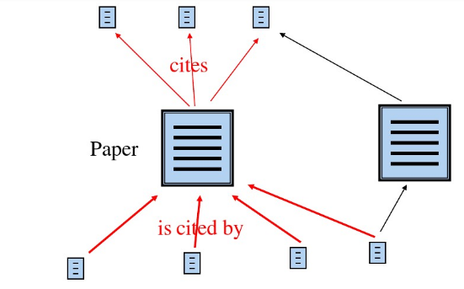
Citation Graph

Slide 11
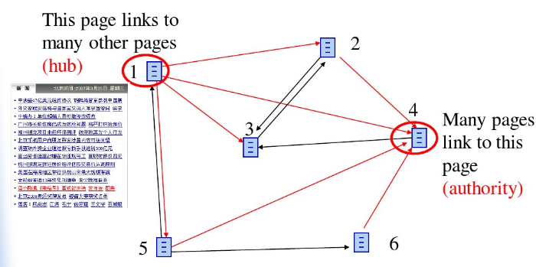
Graphical Analysis of HyperLinks on the Web

Slide 12
Links as Votes
Page is more important if it has more links
in-coming links? out-going links?
Think of in-links as votes
www.stanfor.edu has 23400 in-links
www.joe-schmoe.com has 1-in-lin
Are all in-links are equal?
Links from important pages count more
Recursive question

Slide 13
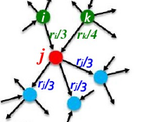

Simple Recursive Formulation
Each link's vote is proportional to the importance of its source page
if page j with importance rj has n out-links, each link gets rj/n votes
page j's own importance is the sum of the votes on its in-links

Slide 14
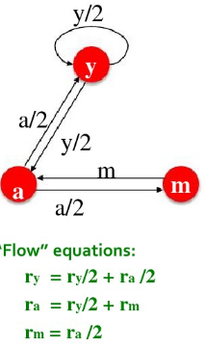
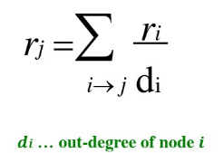
PageRank: The flow Model
A vote from an important page is worth more
A page is important if it is pointed to by other important pages
Define a rank rj for page j

Slide 15
Solving the Flow Equations
If Additional constraint forces:
ry+ra+rm=1
ry=2/5, ra=2/5, rm=1/5
The method works for small examples, but we need a better method for large web-size graphs.

Slide 16
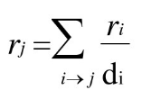

PageRank: Matrix Formulation
Stochastic adjacency matrix M
let page i has di out-links
if i->j, then Mji=1/di, else Mji=0
M is a column stochastic matrix
columns sum to 1
Rank vector r: vector with an entry per page
ri is the importance score of page i
The flow equations can be

Slide 17
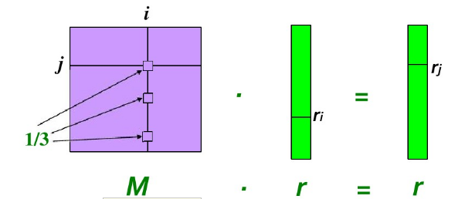
Example
Suppose page i links to 3 pages, including j

Slide 18
PageRank Algorithm
Used to estimate importance of documents.
Concept:
The rank of a web page is higher if many pages link to it.
Links from highly ranked pages are given greater weights than links from less highly ranked pages.

Slide 19
Eigenvector Formulation
The flow equations can be written
The rank vector r is an eigenvector of the matrix M
x is an eigenvector with the corresponding eigenvector value if
We can use Power iteration to solve for r.
Largest eigenvalue of M is 1

Slide 20
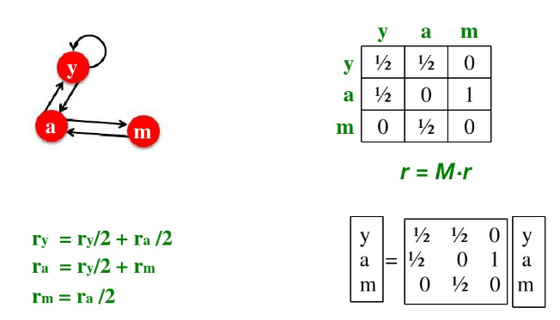
Example

Slide 21
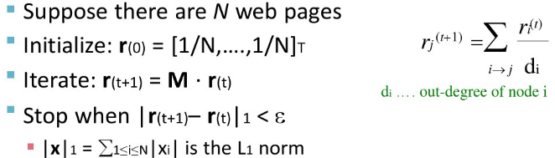
Power Iteration
Given a web graph with n nodes, where the nodes are pages and edges are hyperlinks
Power iteration: a simple iteration

Slide 22
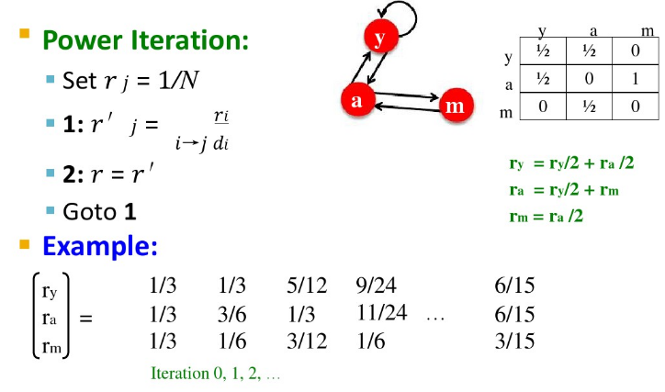
Example

Slide 23
Problems
Dead ends
have no out-links
leak out
Spider traps
all out-links are within the group

Slide 24
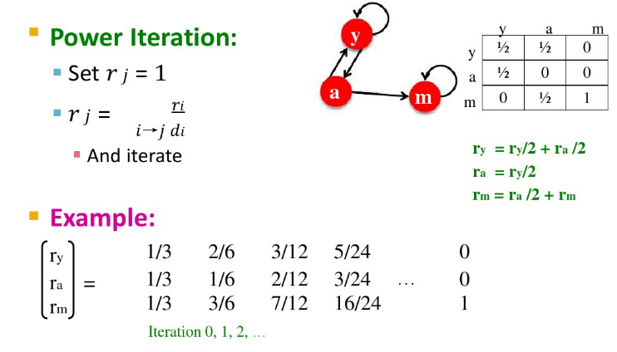
Example: Trap

Slide 25
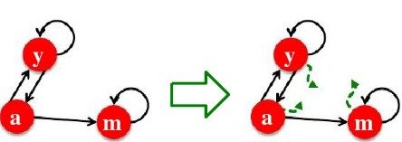
Solution: Random Teleports
The google solution for spider traps: at each time step, the random surfer has two options
with probability to follow a link
with the probability to jump to some random page
common values for the probability ranges from 0.8 to 0.9

Slide 26
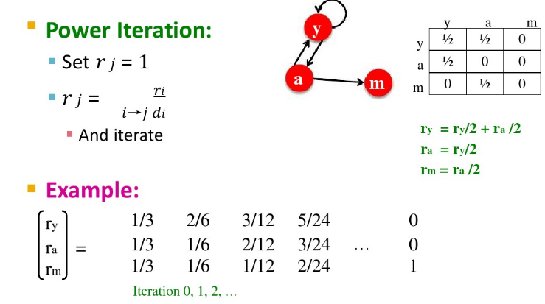
Prolem: Dead Ends

Slide 27
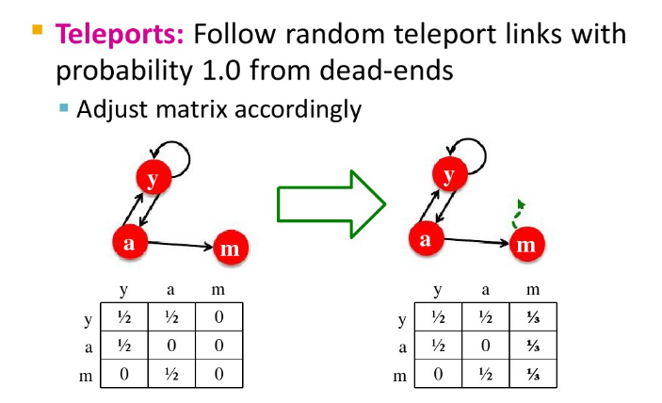
Solution

Slide 28
Problems of PageRank
Using only static web graph structure
Reflecting only the will of web managers, but ignore the will of users, e.g. the staying time of users on a web

Slide 29
Letting web users vote for page importance
When Calculating the page importance,
use the users' real browsing behavior
make no artificial assumption on the user's behavior
Use the users' complete browsing behavior
contain the time information
Browse Rank

Slide 30
Browse Rank
Consider the time spent by the user on the page
Compared with PageRank, browse rank construct a user browsing graph
user transition data
time spent by the user on the page

Slide 31
Browsing Process
Z_{t} is the web page which is accessed by the user at time t.
V is the space which is a set of all the web pages
{Z_{t}, t>=0} contains all the behavior information of the users
{Z_{t}, t>=0} includes some independent sub-process. Each sub-process is a process for a topic. Then, as such independence, we take the sub-process as the target.
{Z_{t}, t>=0} contains 2 information: click and staying time.
Xn is used to signify the web page of nth clicked one in {Z_{t}, t>=0} and Yn is used to signify the staying time on this web page.
Then, {Z_{t}, t>=0} can be transformed to {Z=(Xn, Yn), n>=0}, where, {Xn} is the click process, {Yn} is the staying time process

Slide 32
Browsing Process-A Markov Chain
The transfer from one page to another is by clicking
The process is memoryless

Slide 33

Browsing Process-A Semi-Markov Chain
Y_{n} depends on state X_{n} and X_{n+1} as well as the staying time. Then, {Z_{t}} is a semi-Markov Process.
Ti is the staying time on web page i; Tij is the staying time on the page i when there is a jumping from page i to page j; Tij has a distribution function Fij(t)=P(Tij<=t); pij is the transition probability from the page i to page j. Then, we can have

Slide 34

Browsing Process-A Time Homogeneous Markov Chain
The staying time on a page only relates to the page i
The staying time independents of when the user access to the page
Then, according to the property of time homogeneous markov chain, the staying time Ti on page i follows
is the staying time on page i

Slide 35
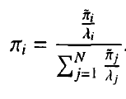
Browsing Process-A Time Homogeneous Markov Chain
The steady state distribution can be computed as

Slide 36
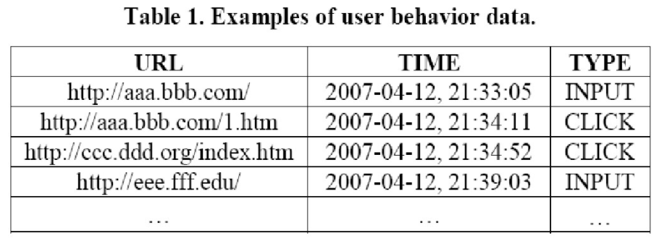
Web Log Example

Slide 37
Pre-Processing
A large body of records in the log.
Cut to generate a split
“Input” is used to generate a process for finding the new topic
The whole log can be divided into seeral splits.
Each split involve just one topic. Each two of the splits are independent.
In each split, the web pages are accessed by “click”.

Slide 38
Pre-Processing
Estimate the re-accessing probability of the web page
When the user input the URL of a web page, a new process of accessing begins.
The web page which is input by the user is important also for the user.
Then, the probability can also reflect the importance degree of some web page.

Slide 39
Pre-Processing
Count the number of the accessing times
The accessing times of a web page reflect the importance degree of the web page also.
Build the pair of the records
In each split, takes the records adjacent to each other as a pair.
The pair of the records reflects that the second page is accessed by clicking the first page.

Slide 40
Pre-Processing
Compute the staying time on a page
For the page except the last one in the split, the time interval between the first and second page in the pair can be used
For the last page in a split,
If the time interval between the page and the next split is bigger than 30 minutes, then, estimate based on the average
Else, take the time interval as the staying time of the last page
Why take 30 minutes as the threshold?

Slide 41
Construct User Browsing Graph
G=<V, W, C, R, Z, γ>
V is a set of vertics
W is the set of the probability from one page to another
C is the set of number of browsing the web page
R is the set of the number of browsing the last web page
S is the set of the staying time of the web page
γ is the set of the probability of the re-accessing probability

Slide 42


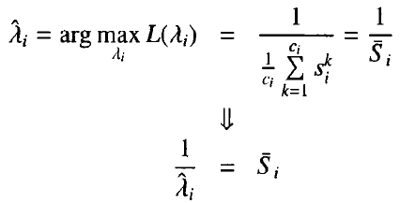
Estimate
According to the likelihood function
for the web page i, we can have samples
Ti follows exponential distribution of
likelihood function
Estimate

Slide 43
Estimate
According to the likelihood function
for the web page i, we can have samples
Ti follows exponential distribution of
likelihood function
Estimate

Slide 44


Estimate others

Slide 45
TrustRank
Spam page should be filtered out
Basic idea
Recognize the high quality page based on human beings
The page linked by this quality page also has high quality.

Slide 46
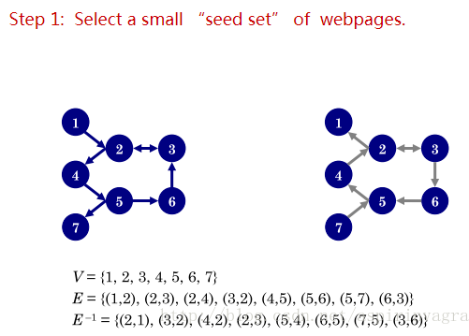
Example

Slide 47
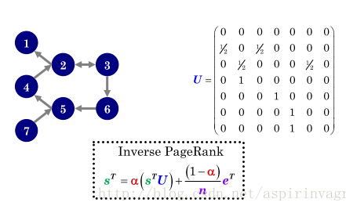
Example

Slide 48
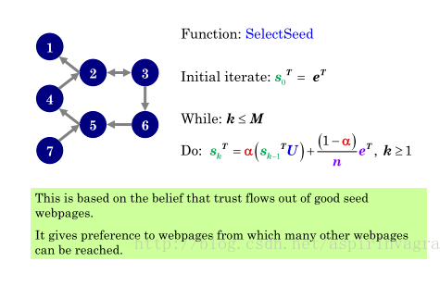
Example

Slide 49
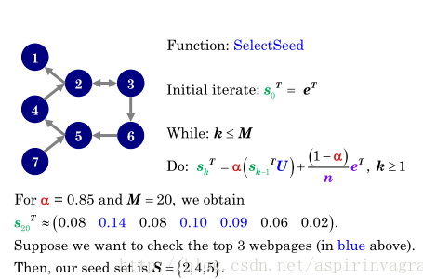
Example

Slide 50
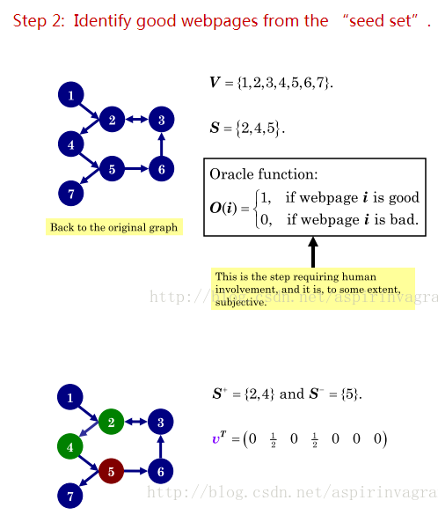
Example

Slide 51
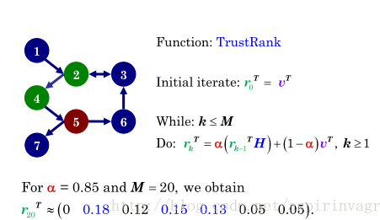
Example
Step 3 Create Personalization vector based on identification of good web pages

Slide 52
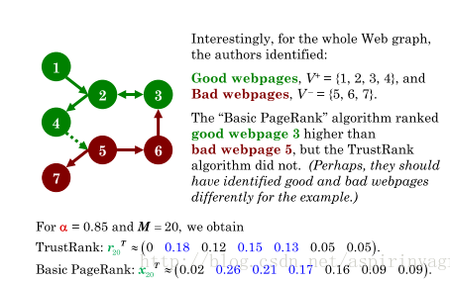
Example

